Slide 1


Mobile Apps Design
Postgrado en
SERVICES
Juan Luis Gorricho

Slide 2
SERVICES
The main purpose of a service is to execute a task in background, without user intervention (no user interface involved).
Nevertheless, the code of the service is executed by the main thread of the app (the UI thread); hence, if the code is computationally intensive it must be delegated to another thread: Thread, AsyncTask for an individual task or a Timer (jointly with a TimerTask) if we want to perform a repeated task.
To execute a task in the future, repeatedly or not, aside from the app. cycle of life, we will have to program an alarm.

Slide 3
SERVICES
What are services useful for?
  Performing operations that need to continue even if the user leaves the application's activities, like a long download (AsyncTask or IntentService ) (as seen with the Google Play Store) or playing music (Foreground) (as seen with Android music apps.).
  Performing operations that need to exist regardless of activities coming and going, such as maintaining a chat connection (Push service) in support of a chat application.
  Providing a local API to remote APIs (bindService), such as might be provided by a Web service, as you want an asynchronous behavior. The service can use AsyncTask to make any remote call.
  Performing periodic work (Alarm + WakefulBroadcastReceiver
+ IntentService) without user intervention, akin to cron jobs or Windows scheduled tasks.

Slide 4
SERVICE START
An open question is when to start a service, there are different alternatives:
  From an activity.
  From the application.
  As a broadcast event.
  Scheduling an alarm.

Slide 5
SERVICE ACTIVATION
A service is started, or it is given something new to do, executing: startService(intent). Android executes onStartCommand(Intent intent, int flags, int startId) of the service.
A service can also be bound using bindService(intent, serviceConnection, Context.BIND_AUTO_CREATE). Android executes onBind(intent) of the service. Once the connection is established, the public methods of the service can be invoked.
5

Slide 6
SERVICE PRIMITIVES
Service activation, here repetition is allowed:
  startService(intent);
Service binding:
  bindService(intent, serviceConnection, Context.BIND_AUTO_CREATE);
Service deactivation:
  stopService(intent);
Service unbinding, repetition is not allowed:
  unbindService(serviceConnection);

Slide 7
SERVICE DEACTIVATION
A service is destroyed itself by calling stopSelf() if it is not bound; or calling stopService() or unbindService() or both, if for unbind it is the last one to unbind from the service.
Note: any component, including activities, can be finished by Android at any time and the execution of onDestroy() is NOT assured.
7

Slide 8
SERVICE CYCLE OF LIFE
8

Slide 9
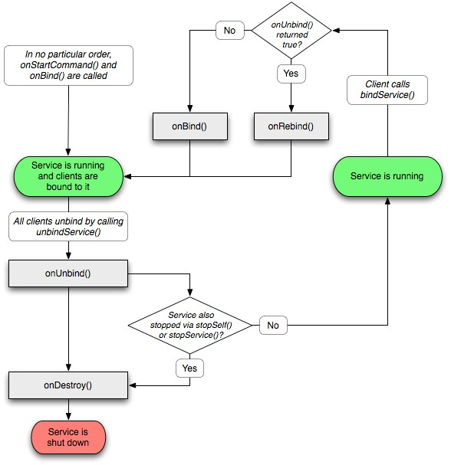
LIFECYCLE OF A BOUND SERVICE
If the service is started and bounded in any order, it will remain active (it’s not destroyed) until it is stopped and unbounded.
The onUnbind() method is called only for the last
The onRebind() method is called only for the first

